Slide 1


MAP Lab
LAB 1 : Introduction to TM4C123 Tiva 4C
Kshitij Hemant Gurjar (SY M.Tech VLSI)
Prof. Y.M. Vaidya
Swapnil Phalke (SY M.Tech VLSI)
MAP Lab

Slide 2
AIM
1.To Understand Bare metal programming and also API Level Programming of TIVA TM4C123GH6PM Modules and Communication protocol.
2.How to configure each register value to set up you controller modules.
3.Understand Important_documents_TM4C123GH6PM contain Data sheet and Pheripheral Driver Library Which you will need to refer for everytime while programming yor board
LAB 1 Introduction to TM4C123
Prereq. - Basic Programming
Kshitij Hemant Gurjar (SY M.Tech VLSI)
Prof. Y.M. Vaidya
Swapnil Phalke (SY M.Tech VLSI)
MAP Lab

Slide 3
Important Documents
TM4C123GH6PM_Microcontroller_Data_Sheet.pdf
TivaWare_Peripheral_Driver_Library__Users_Guide.pdf
LAB 1 Introduction to TM4C123
Tiva_C_Series_TM4C123G_LaunchPad_Evaluation_Kit_Users_Manual.pdf
Kshitij Hemant Gurjar (SY M.Tech VLSI)
Prof. Y.M. Vaidya
Swapnil Phalke (SY M.Tech VLSI)
MAP Lab

Slide 4
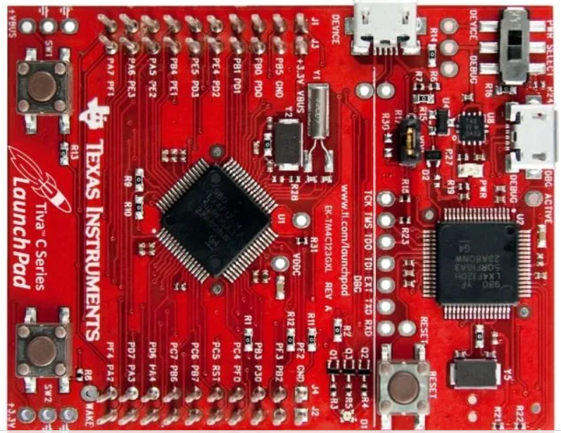
Introduction to TM4C123 Tiva C Series LaunchPad
LAB 1 Introduction to TM4C123
Kshitij Hemant Gurjar (SY M.Tech VLSI)
Prof. Y.M. Vaidya
Swapnil Phalke (SY M.Tech VLSI)
MAP Lab

Slide 5
The TM4C123G is a member of the class of high performance 32 bit ARM cortex M4 microcontroller with a broad set of peripherals developed by Texas Instrumentals.
The TIVA launchpad has a built-in processor clock frequency of up to 80MHz with a floating-point unit (FPU).
The Cortex-M4F processor also supports the tail chaining functionality. It also includes a nested vector interrupt controller (NVIC).
LAB 1 Introduction to TM4C123
Kshitij Hemant Gurjar (SY M.Tech VLSI)
Prof. Y.M. Vaidya
Swapnil Phalke (SY M.Tech VLSI)
MAP Lab

Slide 6
TM4C123G LaunchPad Features
The TM4C123G has a vast variety of applications. It hosts a variety of communication peripherals which can be used to connect all sorts of electronics devices; both sensors and actuators for example IR sensors, motors etc.
The TM4C123G is basically a Thumb216/32 bit code that is 26% memory and 25% faster than 32-bit and has a flexible clocking system and can also access real time clock through hibernation module.
The TM4C123GH6PMI microcontroller of ARM Cortex-M4F operates at 80MHz clock frequency. The clocked source of the I/O port circuitry of the TIVA board can be enabled using the RCGCGPIO register. The clock source of a pin should be disabled if an I/O port is not used to save power.
LAB 1 Introduction to TM4C123
Kshitij Hemant Gurjar (SY M.Tech VLSI)
Prof. Y.M. Vaidya
Swapnil Phalke (SY M.Tech VLSI)
MAP Lab

Slide 7
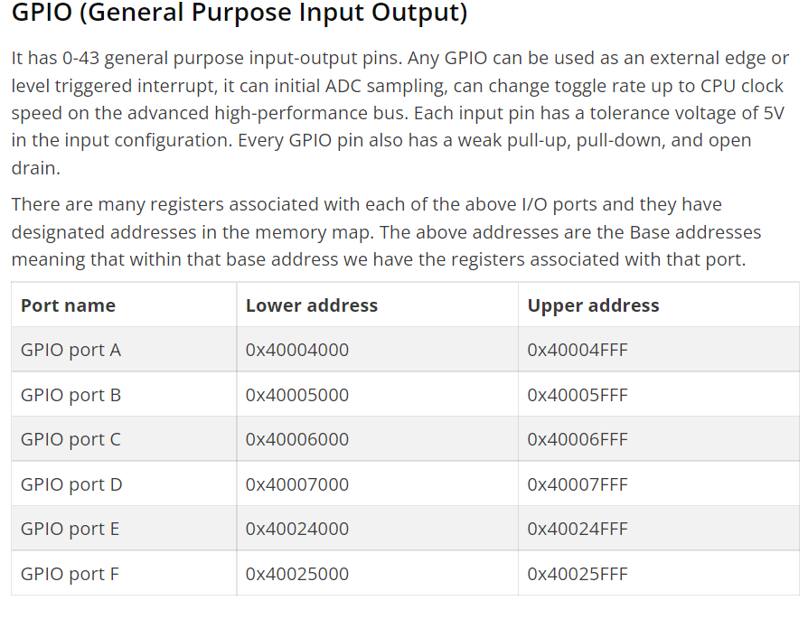
LAB 1 Introduction to TM4C123
Kshitij Hemant Gurjar (SY M.Tech VLSI)
Prof. Y.M. Vaidya
Swapnil Phalke (SY M.Tech VLSI)
MAP Lab

Slide 8
TM4C123G Peripherals and Modules
Memory
It has
• 256 kb Flash memory.
• 32 kb single-cycle SRAM with internal ROM loaded with TivaWare software.
• 2 kb EEPROM which is fast and saves board space
Serial Communication Modules
It also has onboard mounted
USB 2.0 (OTG / HOST / Device)
8 UART ports with IrDA, 9-bit, and ISO7816 port
6 I2C
4 SPI microwire or TI synchronous serial interface
2 CAN Modules
LAB 1 Introduction to TM4C123
Kshitij Hemant Gurjar (SY M.Tech VLSI)
Prof. Y.M. Vaidya
Swapnil Phalke (SY M.Tech VLSI)
MAP Lab

Slide 9
ADC Modules
TM4C123 Tiva C series Launchpad microcontroller has two ADC modules that share 12 analog input channels. On top of that four Sample sequencers are also available as a part of each ADC module to provide different samplig rate, sampling averaging features.
Memory protection unit
It has a built-in feature of generating a memory management fault on incorrect access to region.
Timers
It has 2 watchdog timers with separate clocks
1 SysTick timer, with 24-bit high-speed RTOS and another timer
LAB 1 Introduction to TM4C123
Kshitij Hemant Gurjar (SY M.Tech VLSI)
Prof. Y.M. Vaidya
Swapnil Phalke (SY M.Tech VLSI)
MAP Lab

Slide 10
Nested Vector Interrupt controller (NVIC)
The built-in nested vector interrupt controller is a vector or stack you can say which contains 7 exceptions (defined by the programmer) and 71 interrupts (to be defined by the user) with 8 programmable priority levels. These priority levels decide the priority of the interrupts defined by the user and always have lower priority than the programmer-defined exceptions.
LAB 1 Introduction to TM4C123
Kshitij Hemant Gurjar (SY M.Tech VLSI)
Prof. Y.M. Vaidya
Swapnil Phalke (SY M.Tech VLSI)
MAP Lab

Slide 11
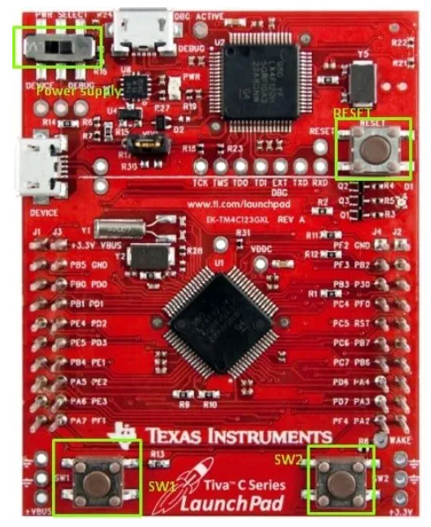
LAB 1 Introduction to TM4C123
Kshitij Hemant Gurjar (SY M.Tech VLSI)
Prof. Y.M. Vaidya
Swapnil Phalke (SY M.Tech VLSI)
MAP Lab

Slide 12
Assignment 1 :
What is Embedded C Programming? How is Embedded C different from C language?
What is ISR?
What is Void Pointer in Embedded C and why is it used?
Why do we use the volatile keyword?
How will you use a variable defined in source file1 inside source file2?
LAB 1 Introduction to TM4C123
Kshitij Hemant Gurjar (SY M.Tech VLSI)
Prof. Y.M. Vaidya
Swapnil Phalke (SY M.Tech VLSI)
MAP Lab

